Slide 1
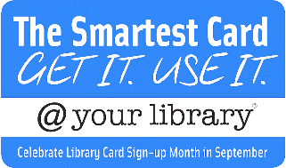
NC Public Libraries
are transforming lives everyday by providing access to technology, early literacy programs and career development resources to local communities. Here’s a look at how many lives we’ve touched in the past year and we’ve got even more planned this year!
NC Libraries are learning centers
Last year
library programs were attended by
2.7 million
126,583
people
Libraries
offered:
86,008
Early literacy programs
39,069
Programs for teens and adults
3,945
Workforce development programs
NC Libraries are technology hubs
Access
Assistance
11,470
1.9 million
1,927,895 Wi-Fi sessions
9,340,714 Computer uses
Technology classes offered
Technology questions answered
NC Libraries provide Access to Millions of resources
35,523,633 library visits
5,145,297 active library users
That’s more
than half of
NC residents.
52,564,479 items circulated
That’s more than 3 visits per resident.
That’s over 5 items per NC resident.
A NC library card gets you access to over 483,491,528 items including e-books, audiobooks, movies, music and much more!
You can access library materials 24/7! Download ebooks, stream films, or learn a language all through the library’s website.
This flyer was created to celebrate National Library Week! April 10-16, 2016

